Slide 1

Reconocimiento de Patrones
Domingo Mery
Departmento de Ciencia de la Computación
Escuela de Ingeniería
Universidad Católica de Chile
Semestre 2018-1
Applications with X-ray Testing
[ Capítulo 7 ]

Slide 2





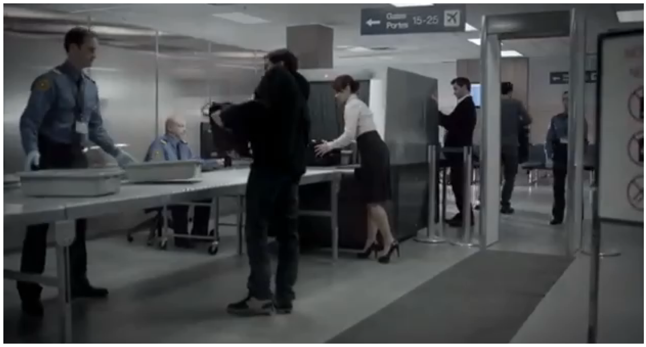
Baggage inspection
Notes:
Let me introduce to you a friend of mine: Miguel. Hi is a wonderful guy, but he does not like his job
Why? Because it is very boring

Slide 3
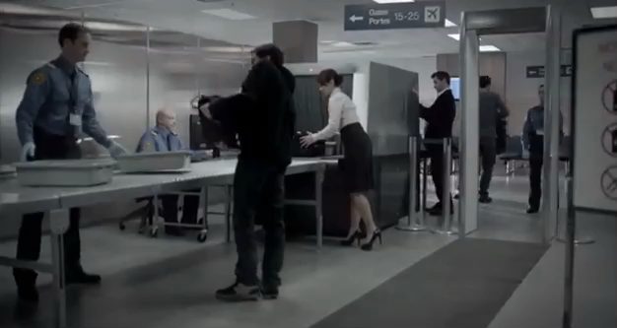
Baggage inspection
Notes:
Let me introduce to you a friend of mine: Miguel. Hi is a wonderful guy, but he does not like his job
Why? Because it is very boring

Slide 4

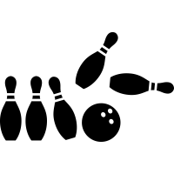

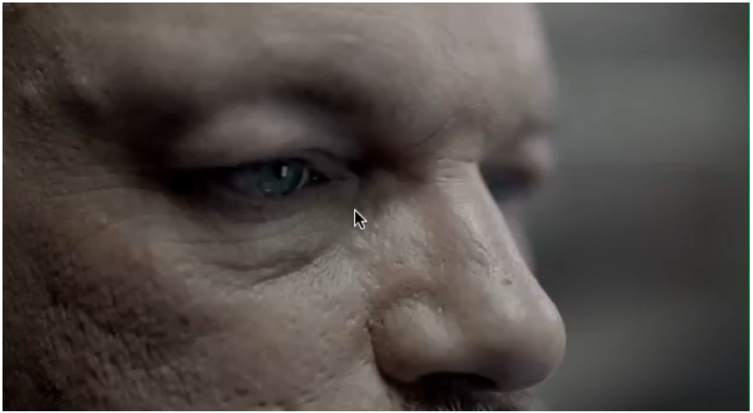
Baggage inspection
Notes:
He use to think in beautiful thinks like
how to play with his grandchildren,
The last soccer game - the weekend with his wife

Slide 5
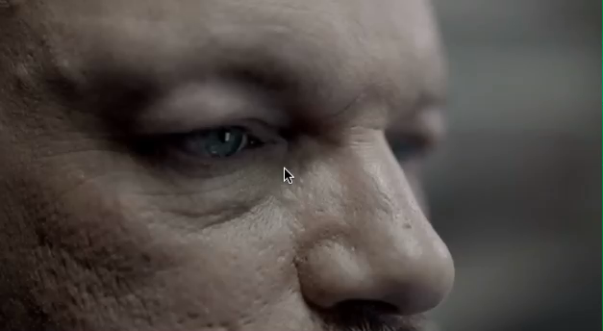
Baggage inspection
Notes:
He use to think in beautiful thinks like
how to play with his grandchildren,
The last soccer game - the weekend with his wife

Slide 6
Baggage inspection
Only 85% of the threat objects are detected
Notes:
He use to think in beautiful thinks like
how to play with his grandchildren,
The last soccer game - the weekend with his wife

Slide 7
Can Computer Vision be used to
Aid Human Baggage Inspection?

Slide 8
Can Computer Vision be used to
Aid Human Baggage Inspection?

Slide 9

Can Computer Vision be used to
Aid Human Baggage Inspection?

Slide 10
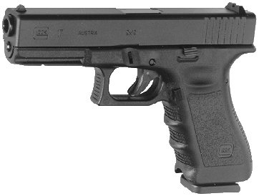
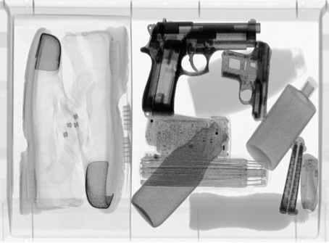
Principles: X-ray projection
X-Ray
source
Inner part
X-ray
source
inside
Target object
X-ray detector
X-ray image

Slide 11
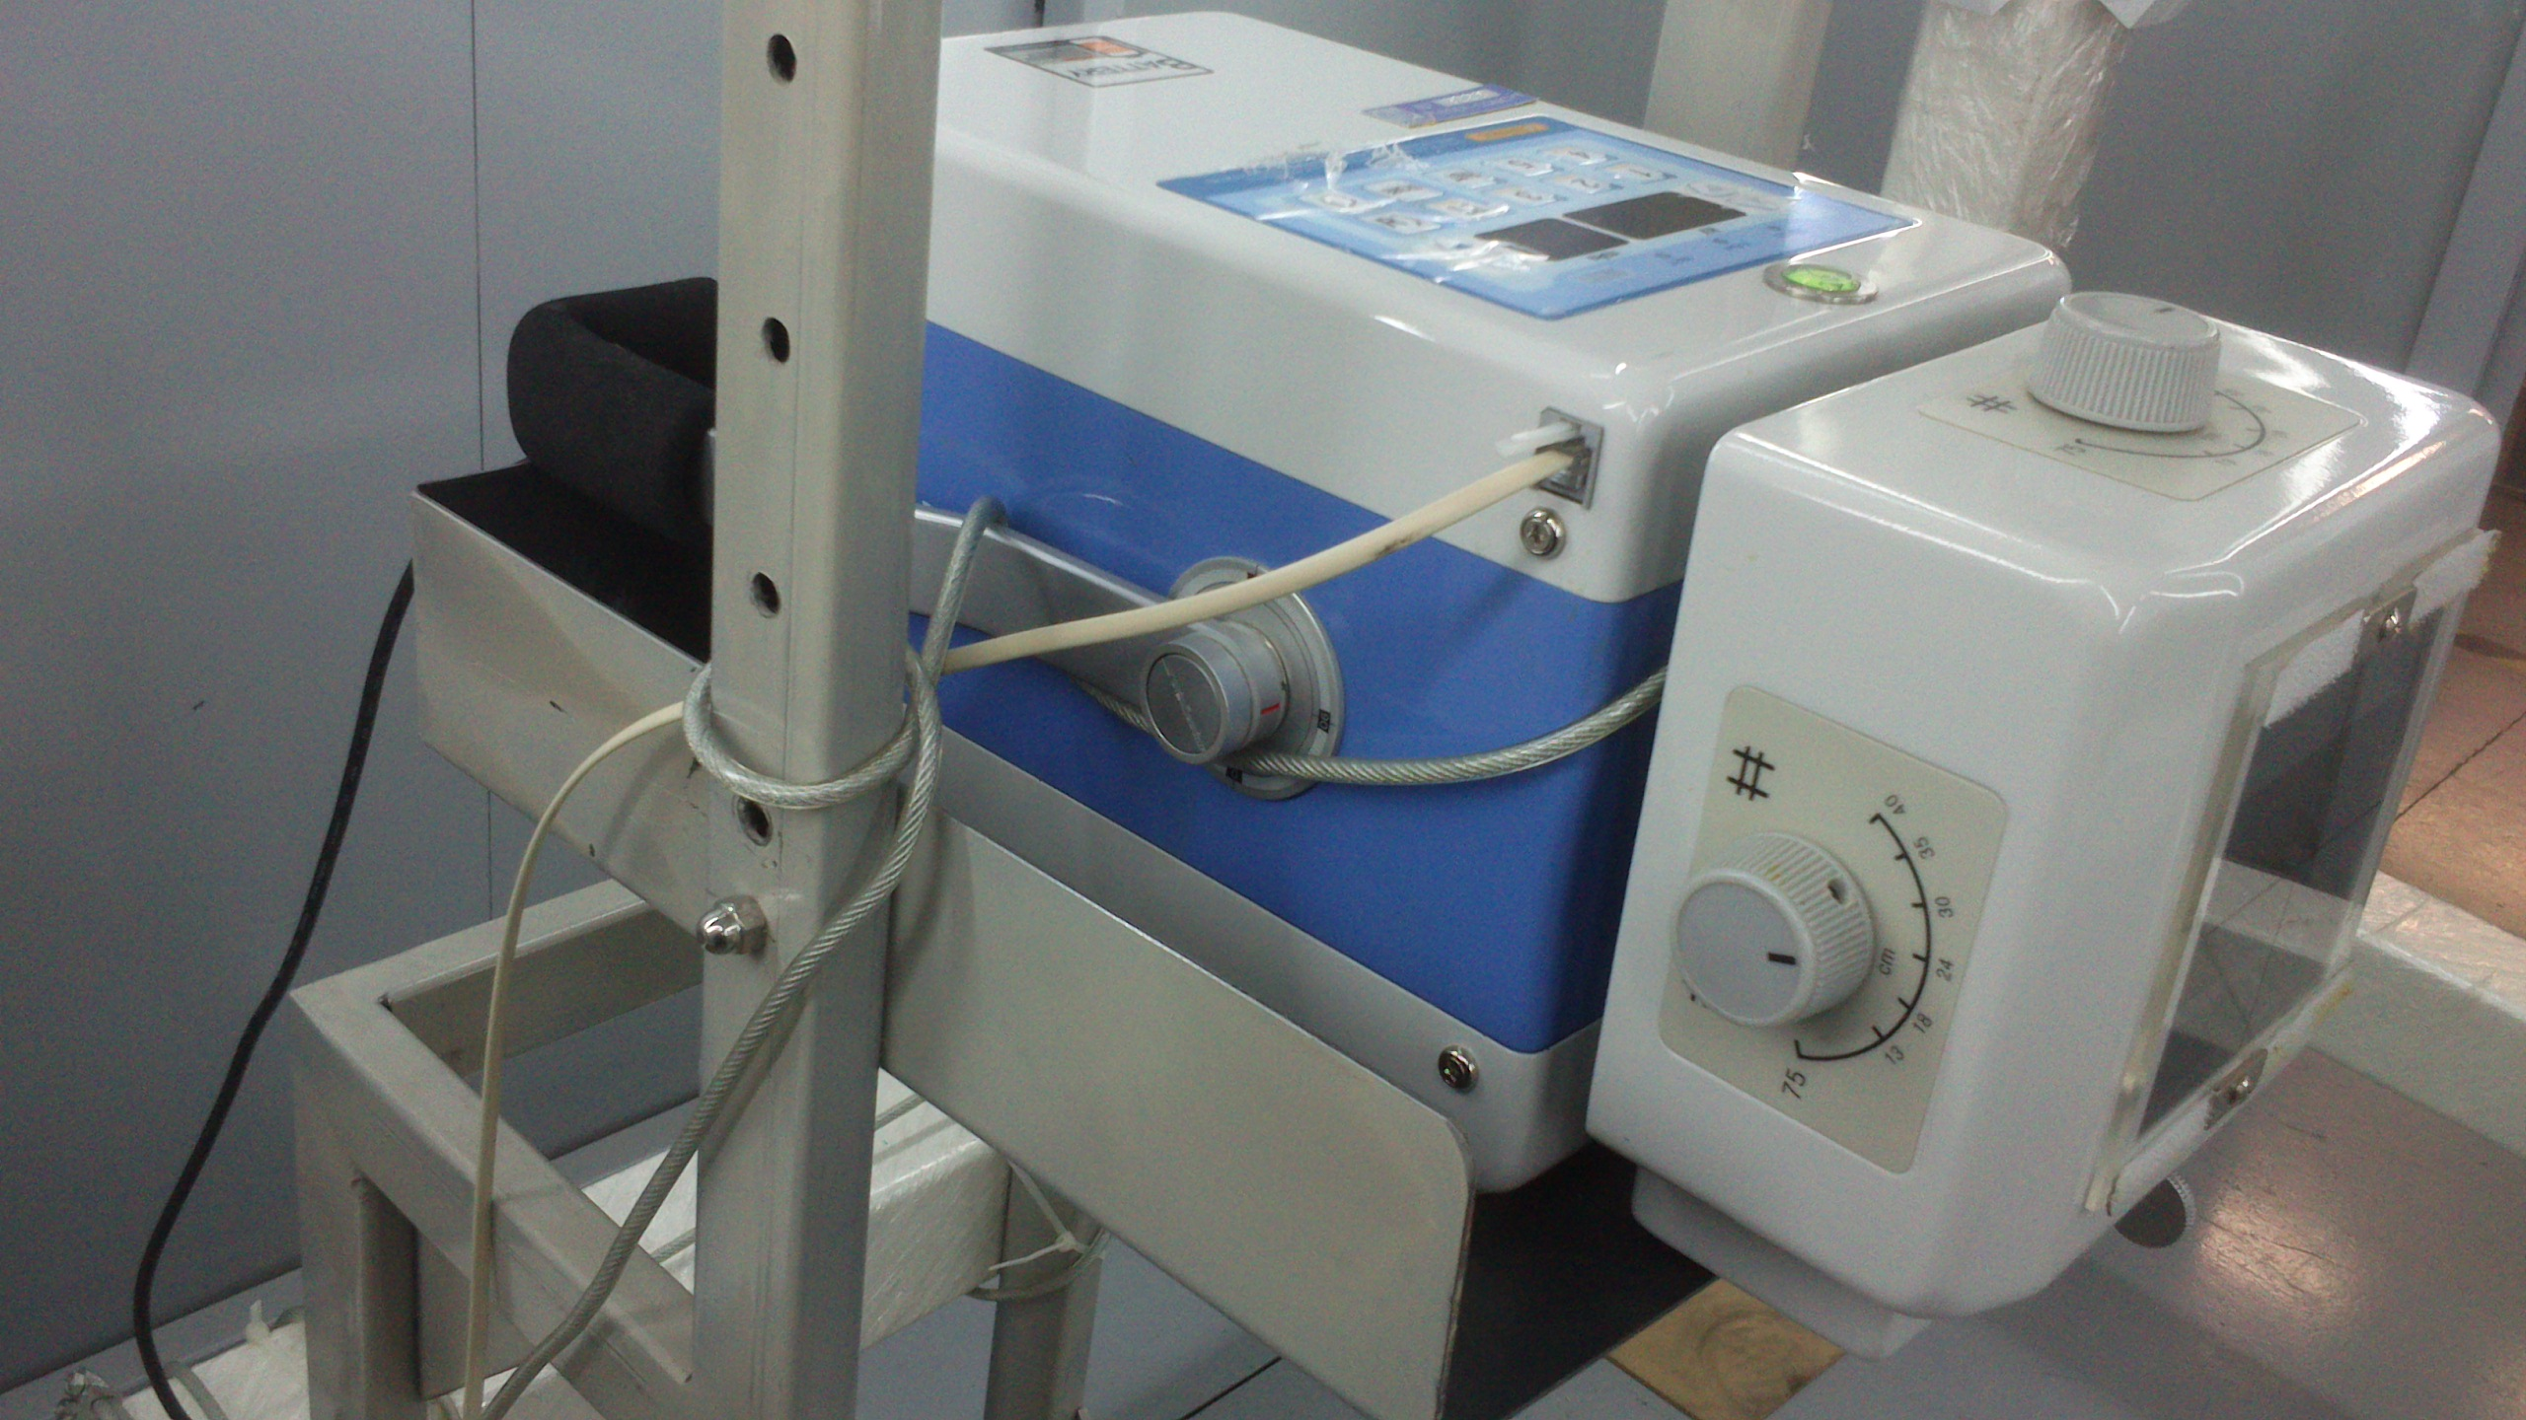
Principles: X-ray system
X-ray Testing Lab at UC – Santiago, Chile

Slide 12
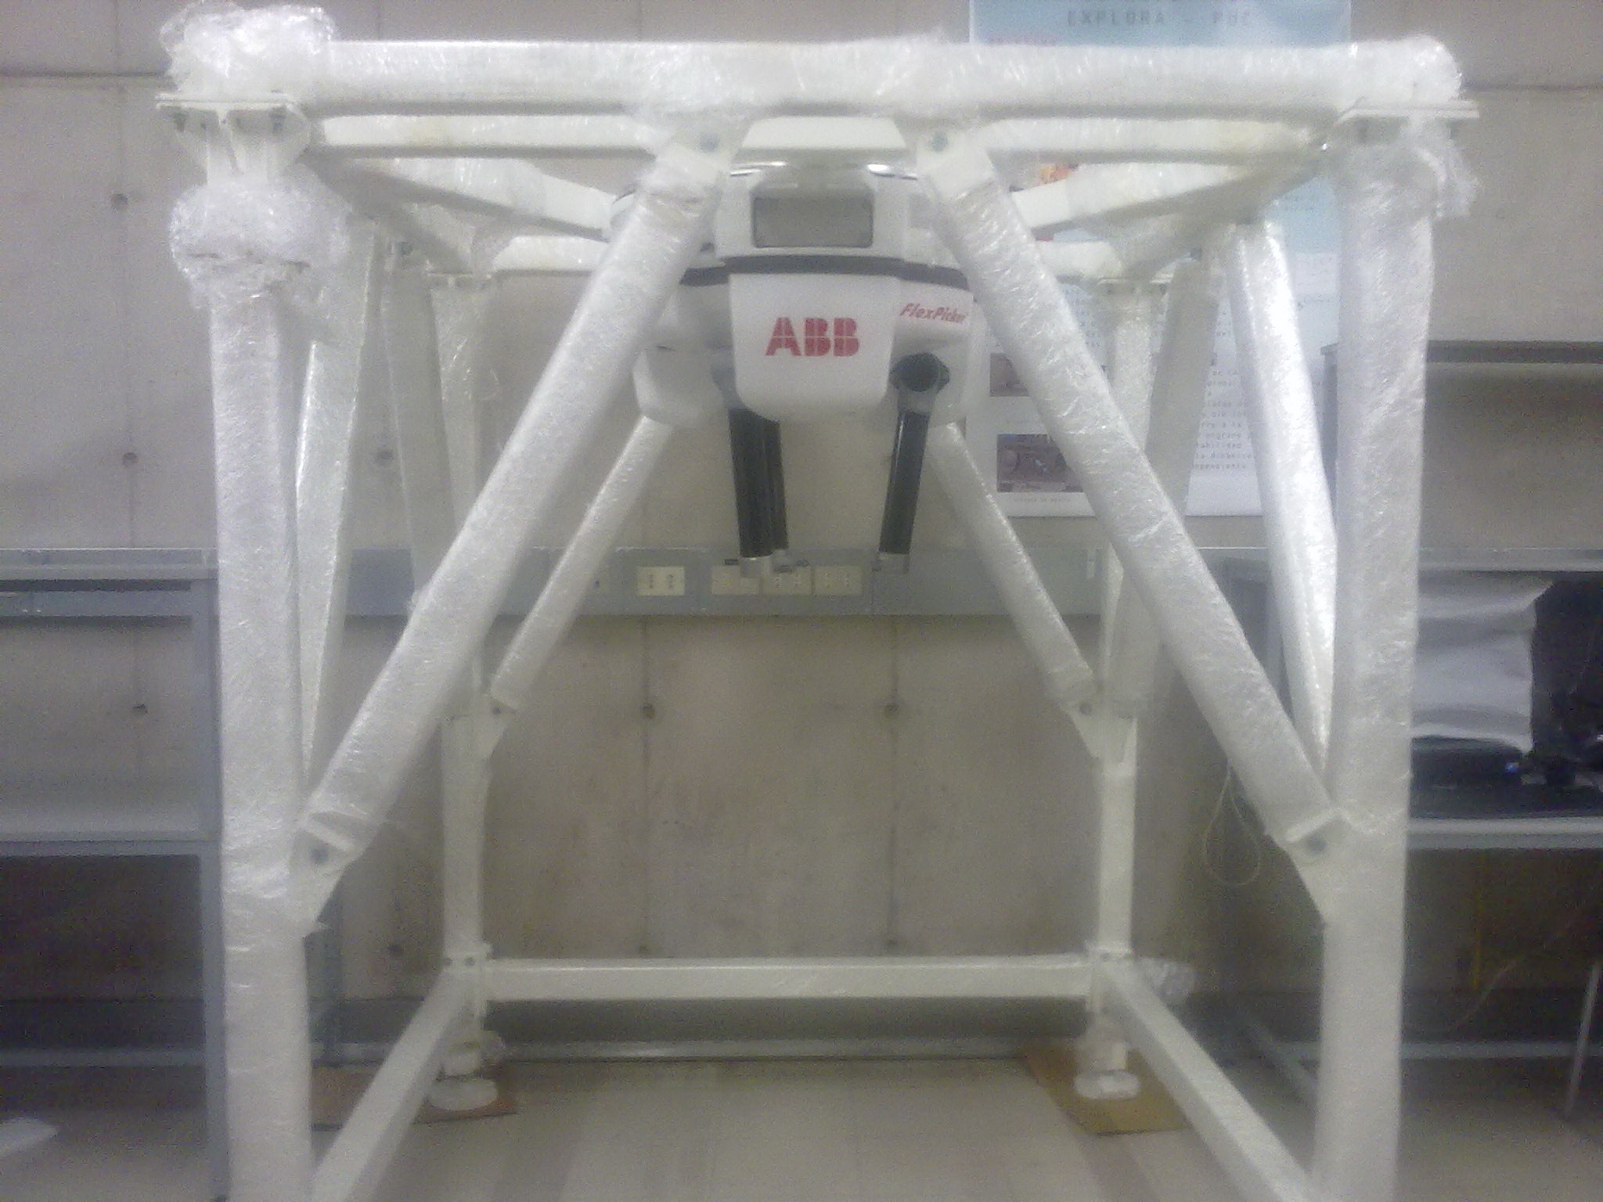
Principles: X-ray system
X-ray Testing Lab at UC – Santiago, Chile

Slide 13
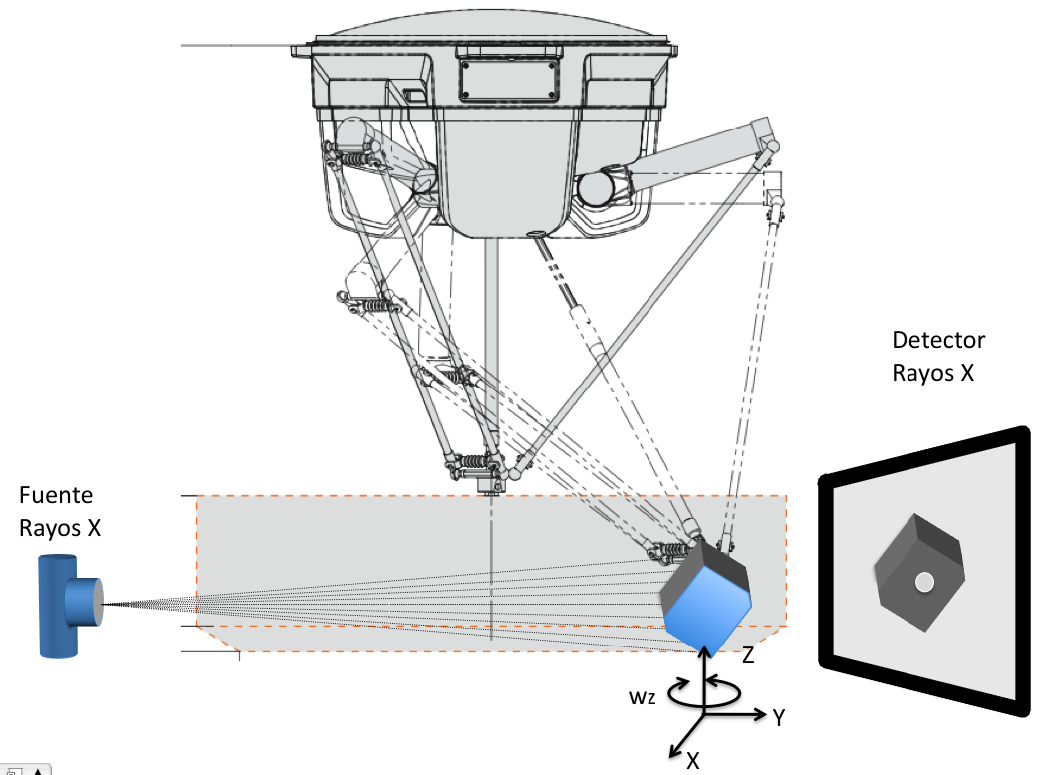
Principles: X-ray system

Slide 14
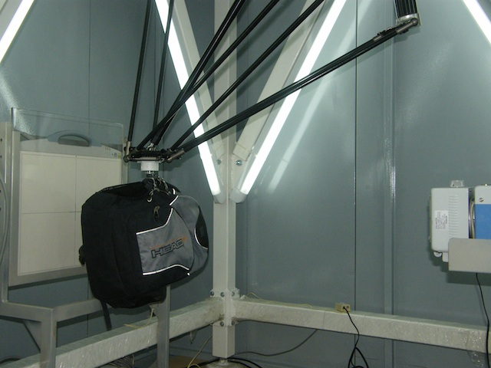
Principles: X-ray system
X-ray Testing Lab at UC – Santiago, Chile

Slide 15
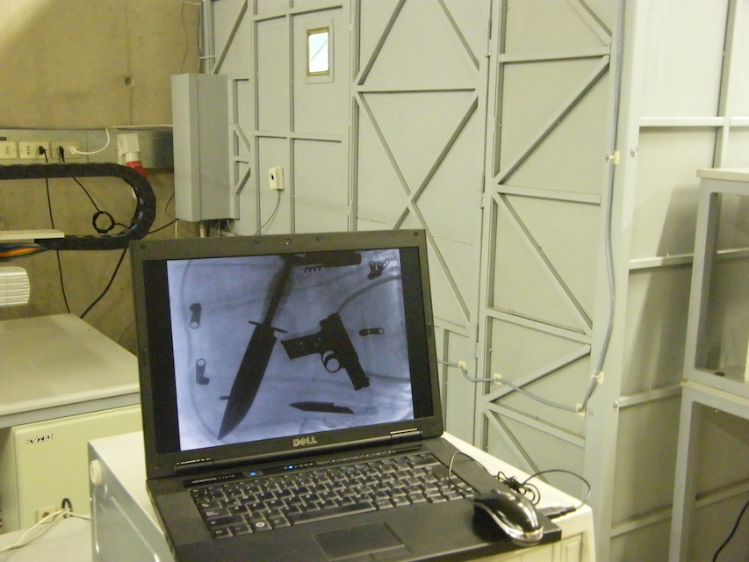
Principles: X-ray system
X-ray Testing Lab at UC – Santiago, Chile

Slide 16
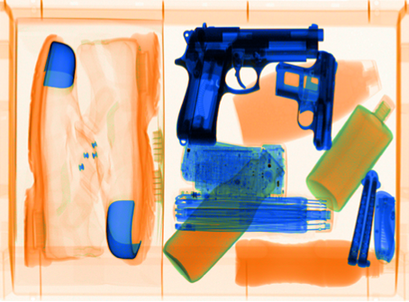
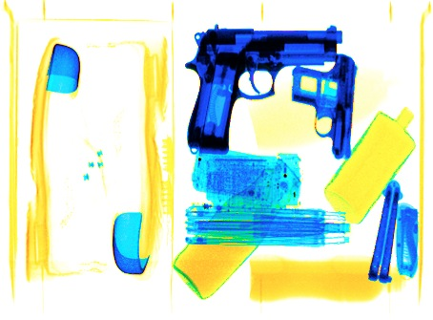
Principles: Dual Energy
v
u
Low Energy X-ray Image
v
u
Hi Energy X-ray Image
v
u

Slide 17
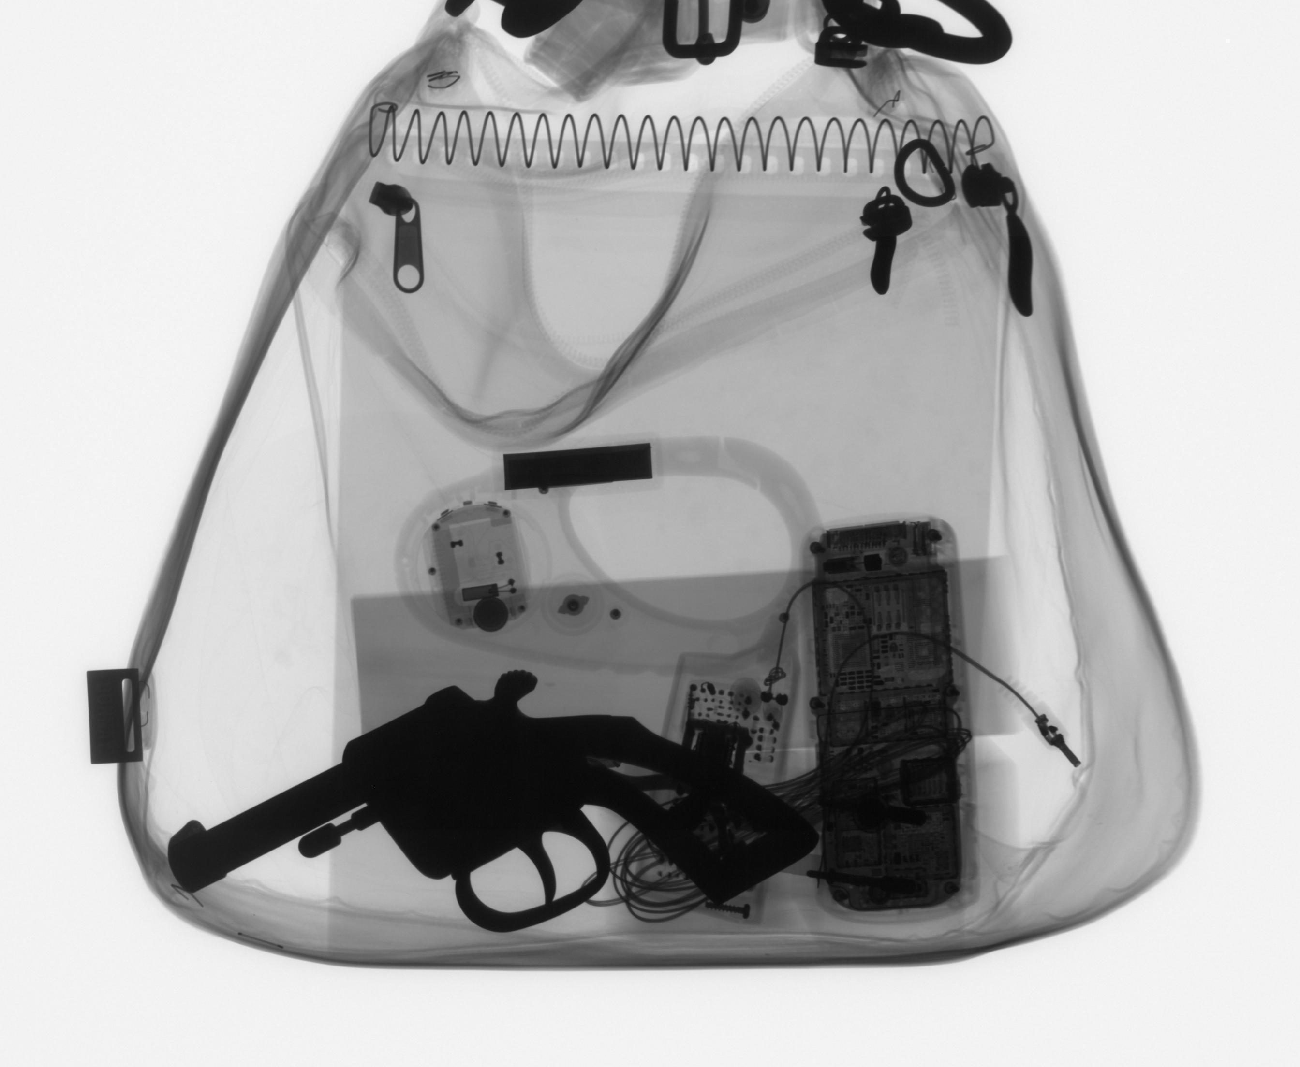
Principles: Single view analysis – Sliding Windows

Slide 18
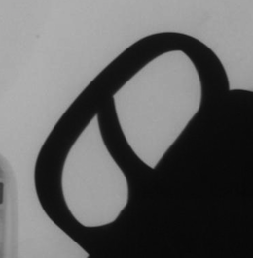
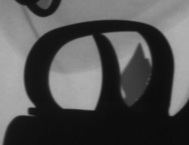
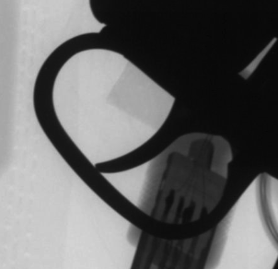
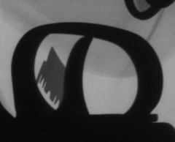
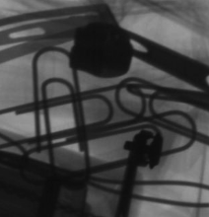
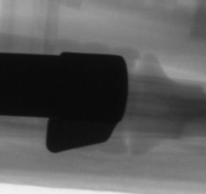
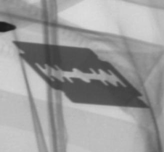
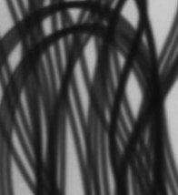
Principles: Detection
Example: Trigger detection
Positive Samples
Positive & Negative samples
...
Feature
Extraction
Negative Samples
Feature
Selection
...
Classifier

Slide 19
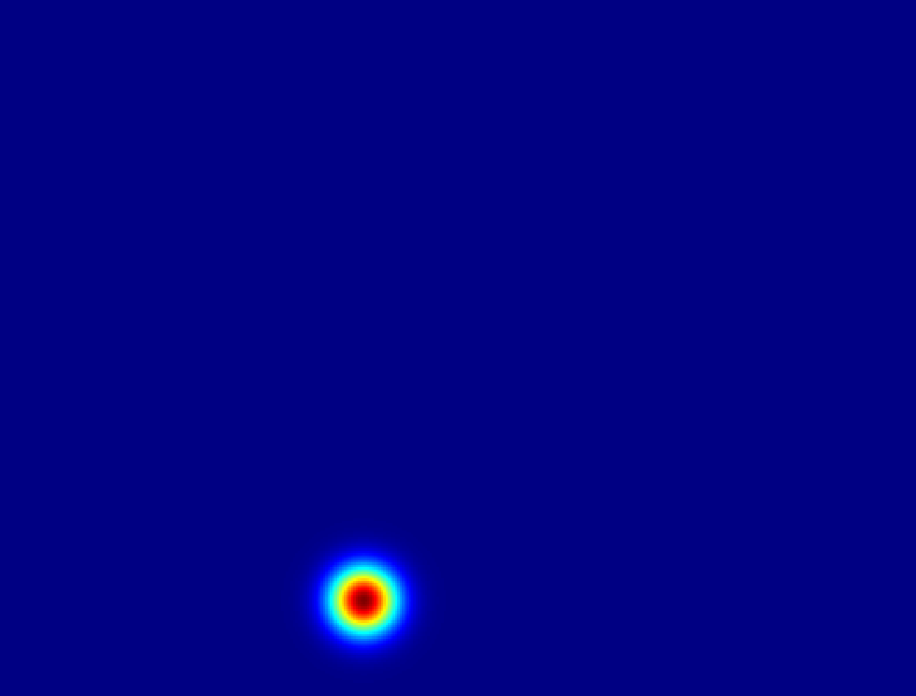
Principles: Single view analysis – Sliding Windows

Slide 20
Principles: Single view analysis – Sliding Windows

Slide 21
Images of different
known classes
Representation
Feature
Extraction
Class 1
Feature Design of
Selection Classifier
Class 2
Class n
Stage 1: TRAINING
Stage 2: TESTING
Extraction of
selected
features
Input: Test Image
Class
Classification
Output:

Slide 22
Principles: Image representation
Handcrafted or Learned features ?
Gabor, LBP, Haralick, Fourier, etc.
or
Learned representation from training data

Slide 23
Principles: Image representation
Handcrafted or Learned features ?
Gabor, LBP, Haralick, Fourier, etc.
or
Learned representation from training data

Slide 24
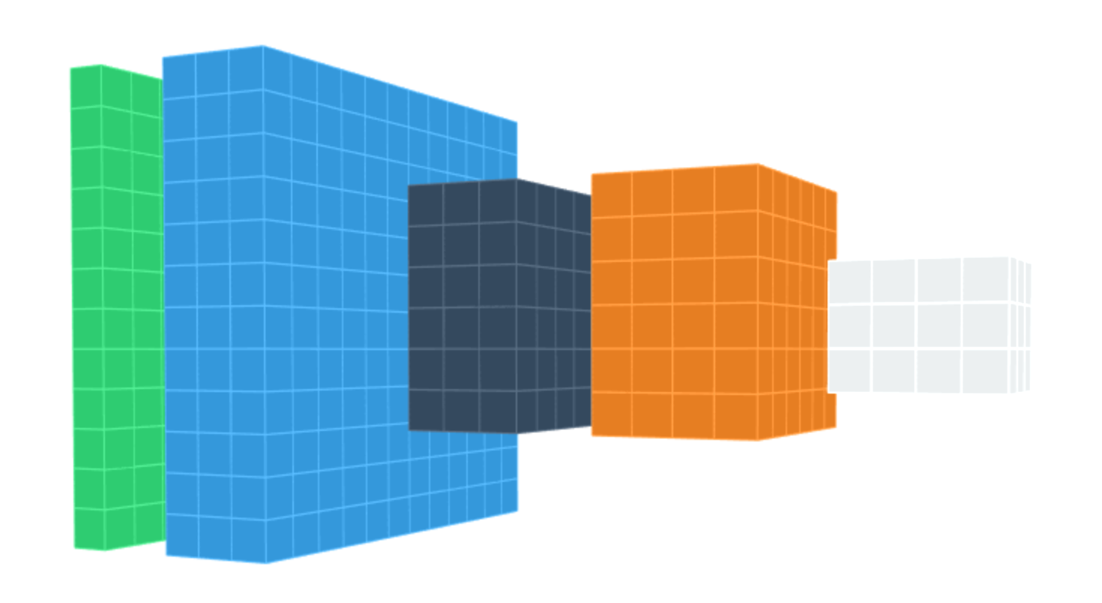
Principles: Deep learning
Data
representation
Input
image
Layers

Slide 25
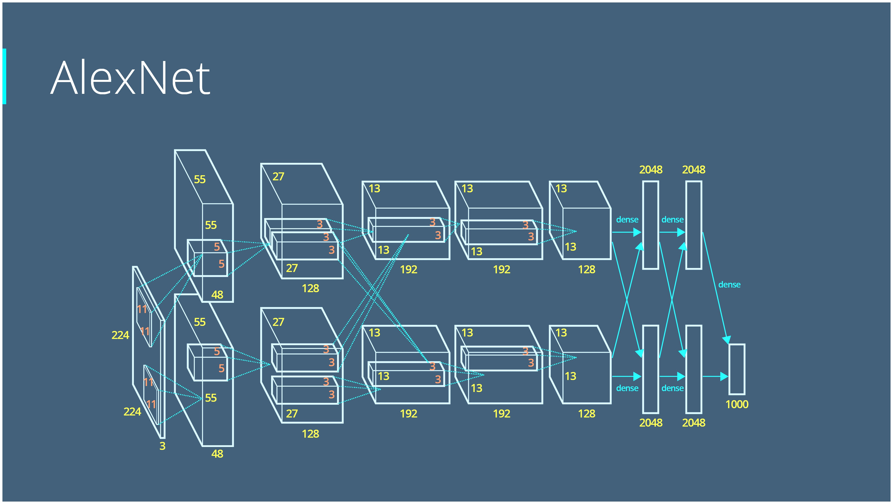

Slide 27
VGG-net

Slide 28
Images of different
known classes
Representation
Feature
Extraction
Class 1
Feature
Selection
Design of
Classifier
Class 2
Class n
Stage 1: TRAINING
Stage 2: TESTING
Extraction of
selected
features
Input: Test Image
Class
Classification
Output:

Slide 29
Images of different
known classes
Representation
Deep Learning
Model
Class 1
Learned
Features
Design of
Classifier
Class 2
Class n
Stage 1: TRAINING
Stage 2: TESTING
Extraction of
learned
features
Input: Test Image
Class
Classification
Output:

Slide 30
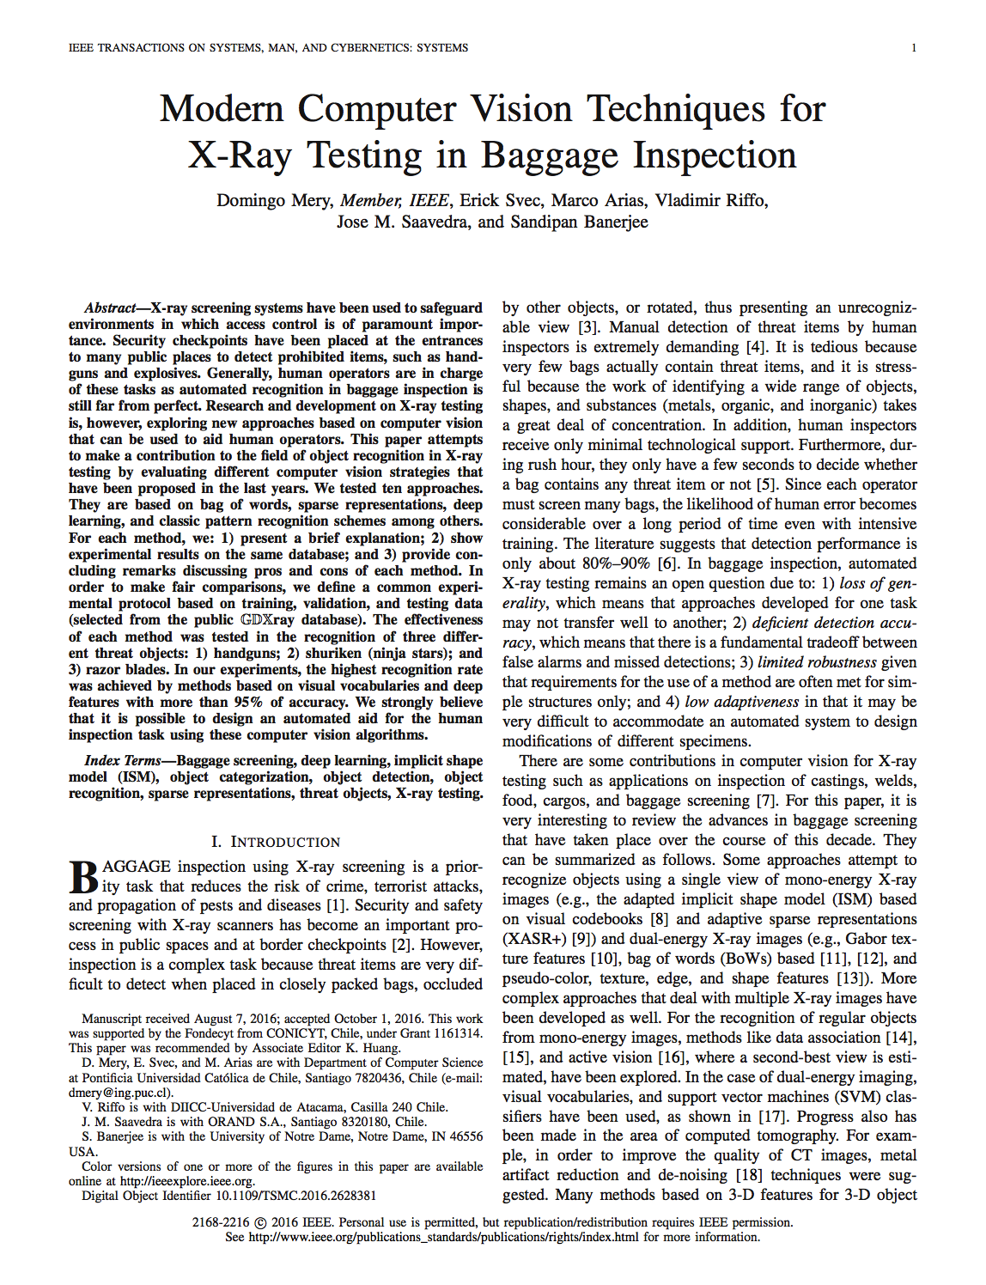
Single Views Method 4: Deep Learning
4
D. Mery, E. Svec, M. Arias, V. Riffo, JM Saavedra, S. Banerjee: Modern Computer Vision Techniques for X-ray Testing in Baggage Inspection, IEEE Trans. SMC, 2016

Slide 31
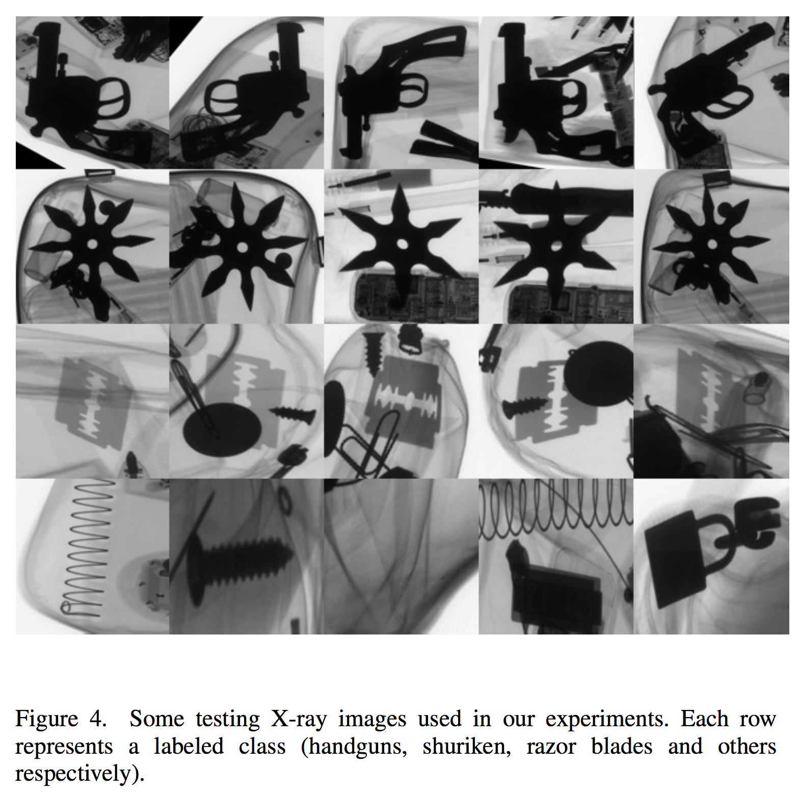
X-ray testing: Baggage screening – Single view
4

Slide 32
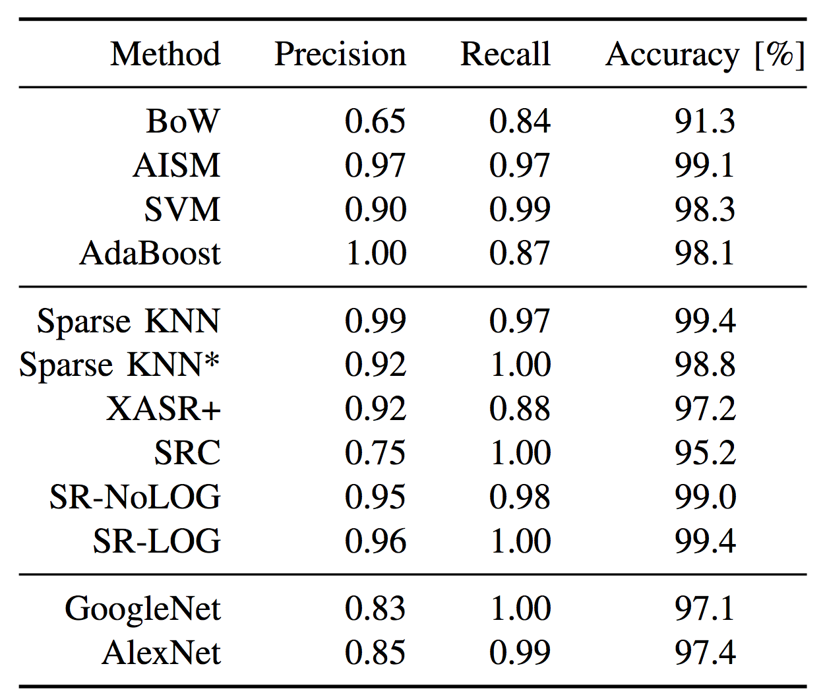
Comparison – Detection of Handgun
4
Experiments on 1.950 X-ray images

Slide 33
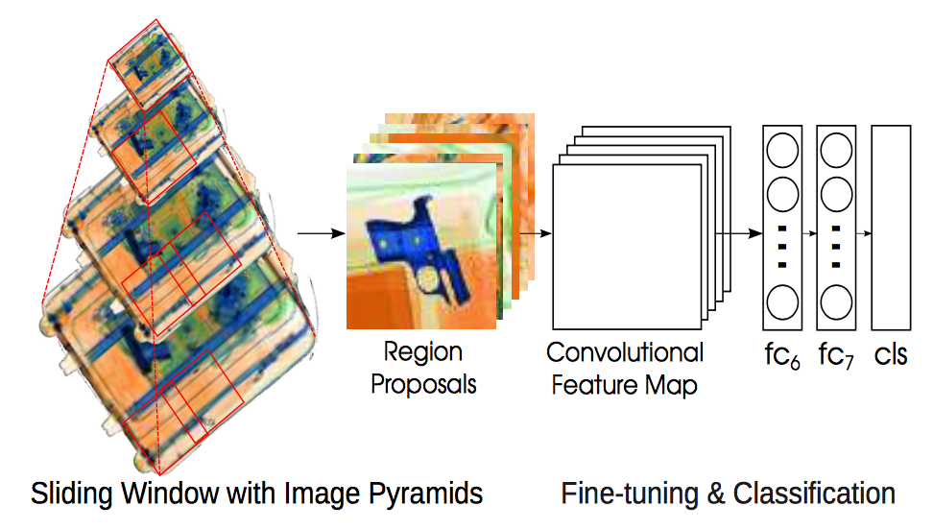
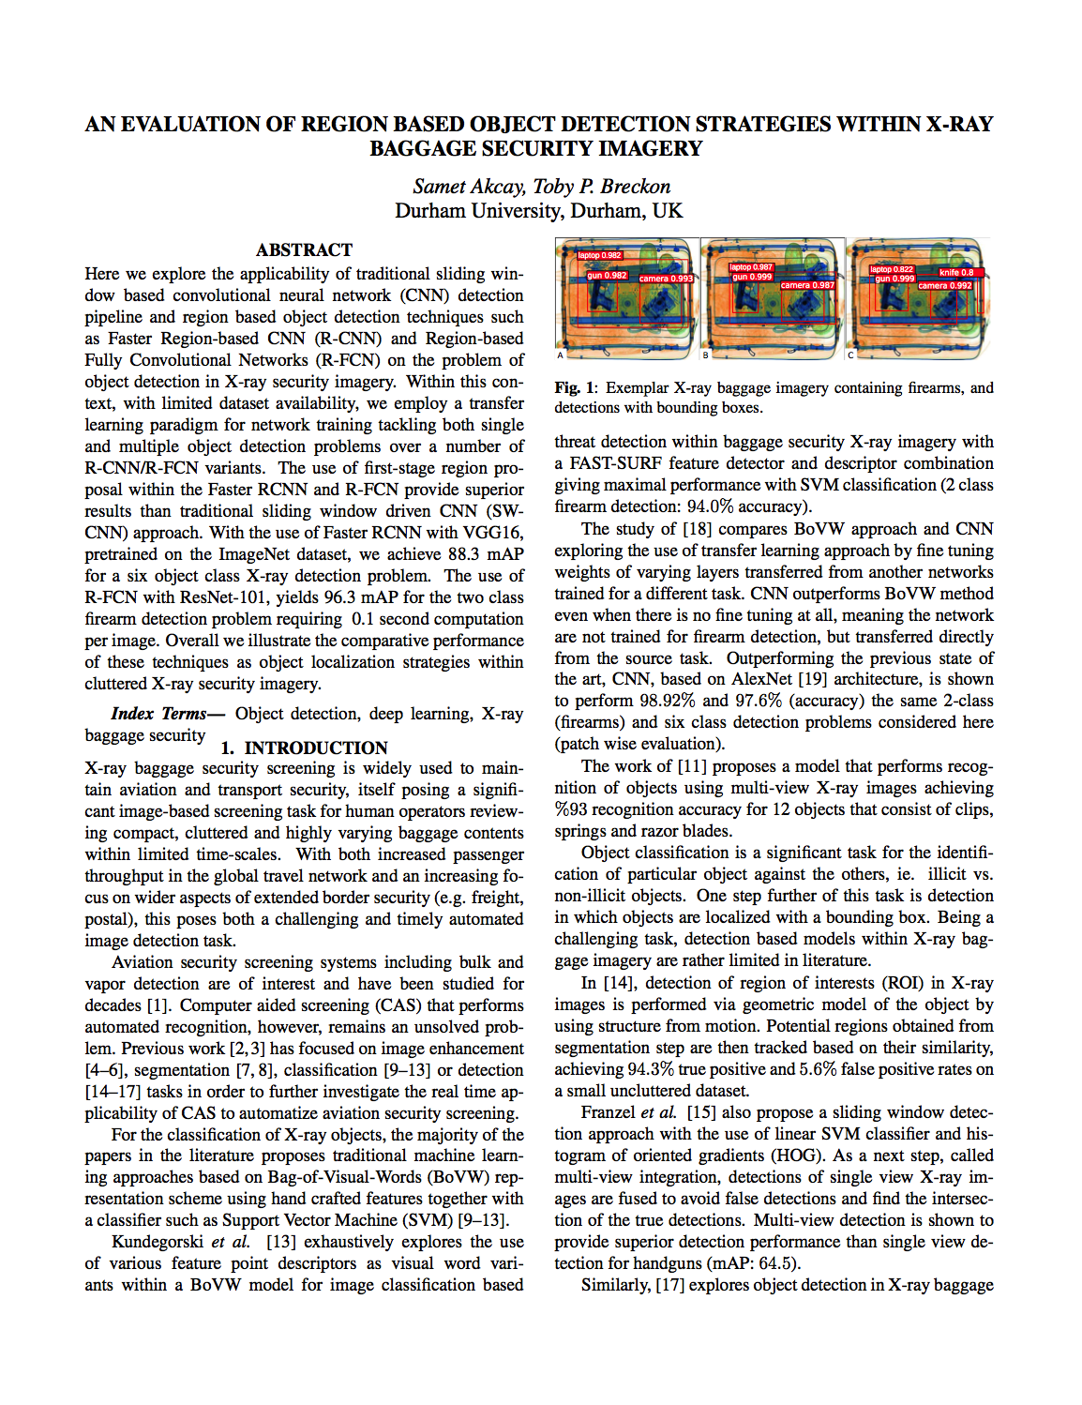
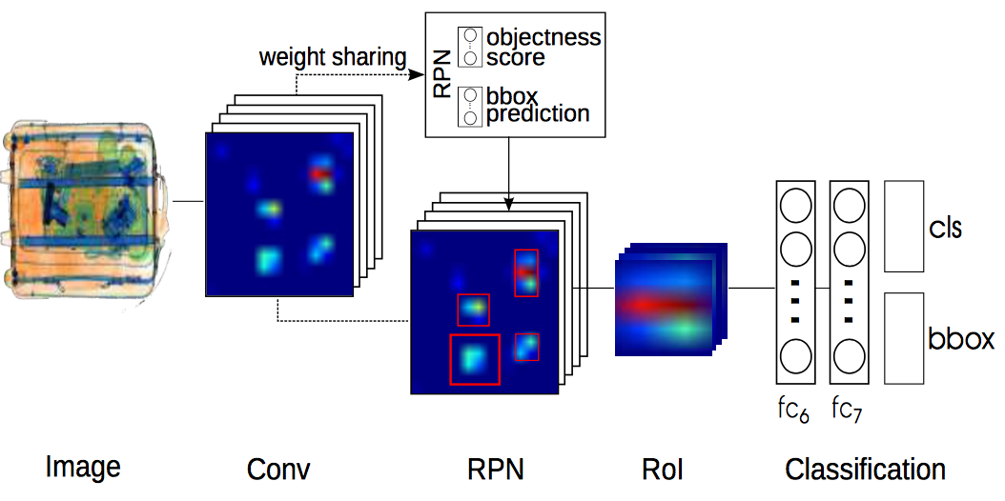
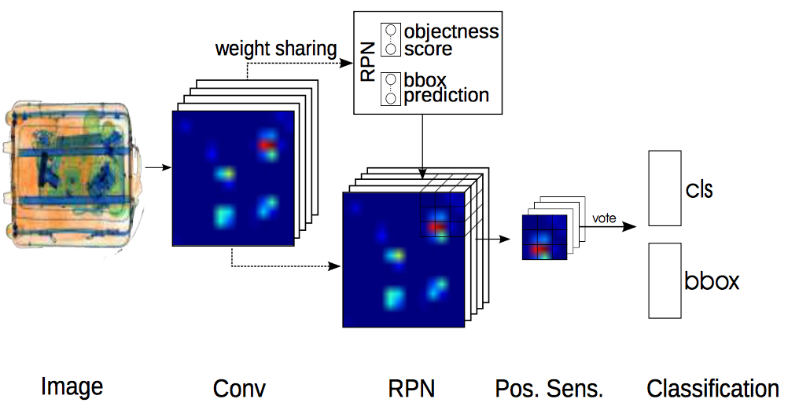
Single Views Method 4: Deep Learning
4
S. Ackay, T. Breckon: An evaluation of region based object detection, IEEE ICIP, 2017
SW-CNN
RCNN
R-FCN

Slide 34
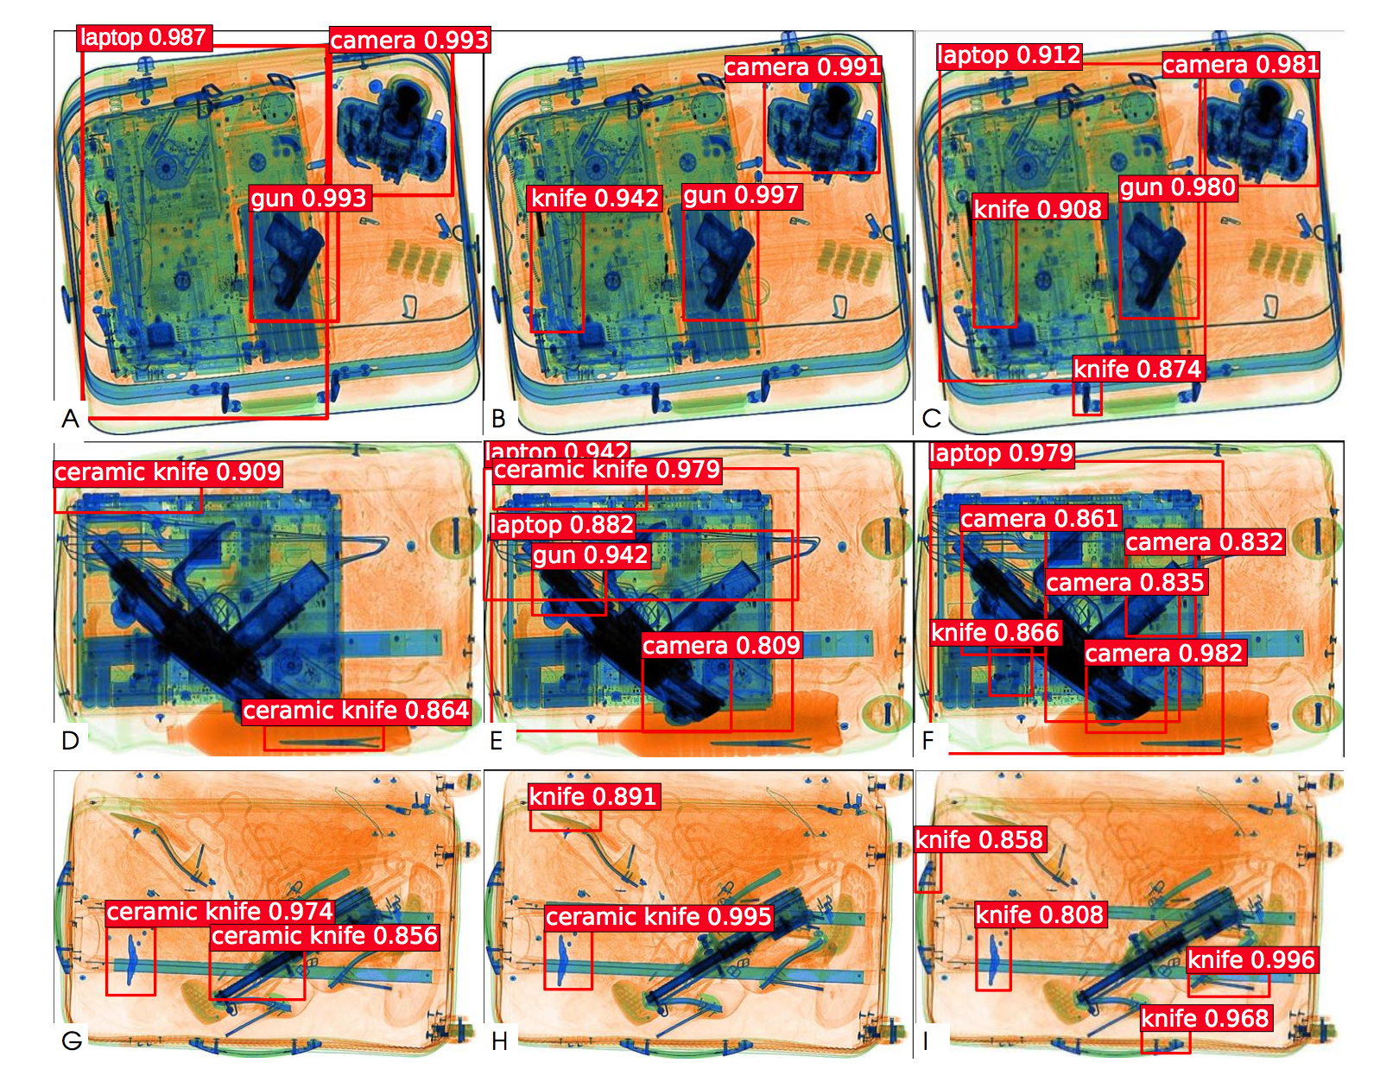
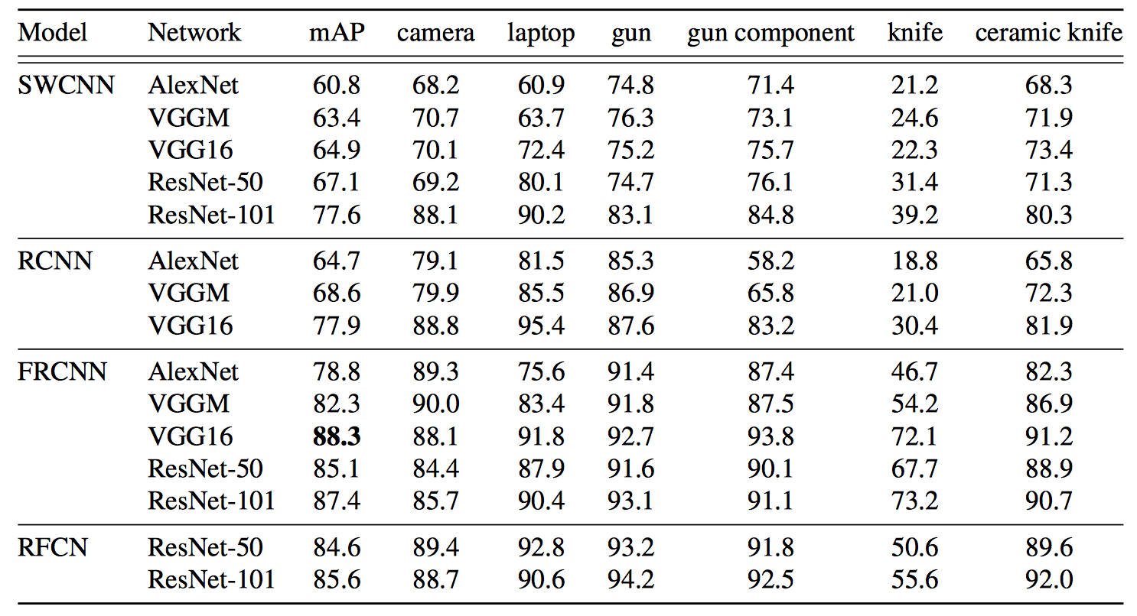
4
S. Ackay, T. Breckon: An evaluation of region based object detection, IEEE ICIP, 2017

Slide 35
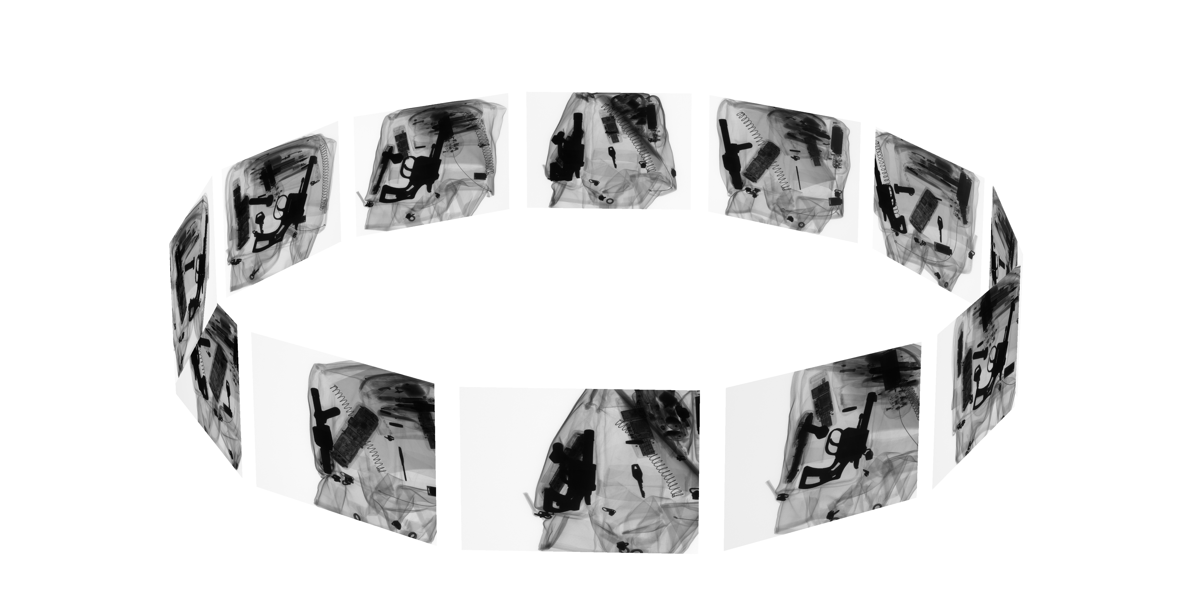
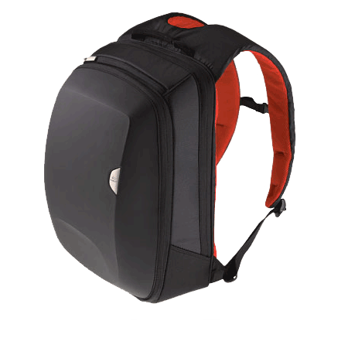
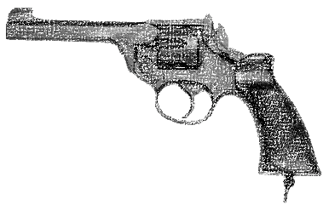
Principles: Computed Tomography

Slide 36
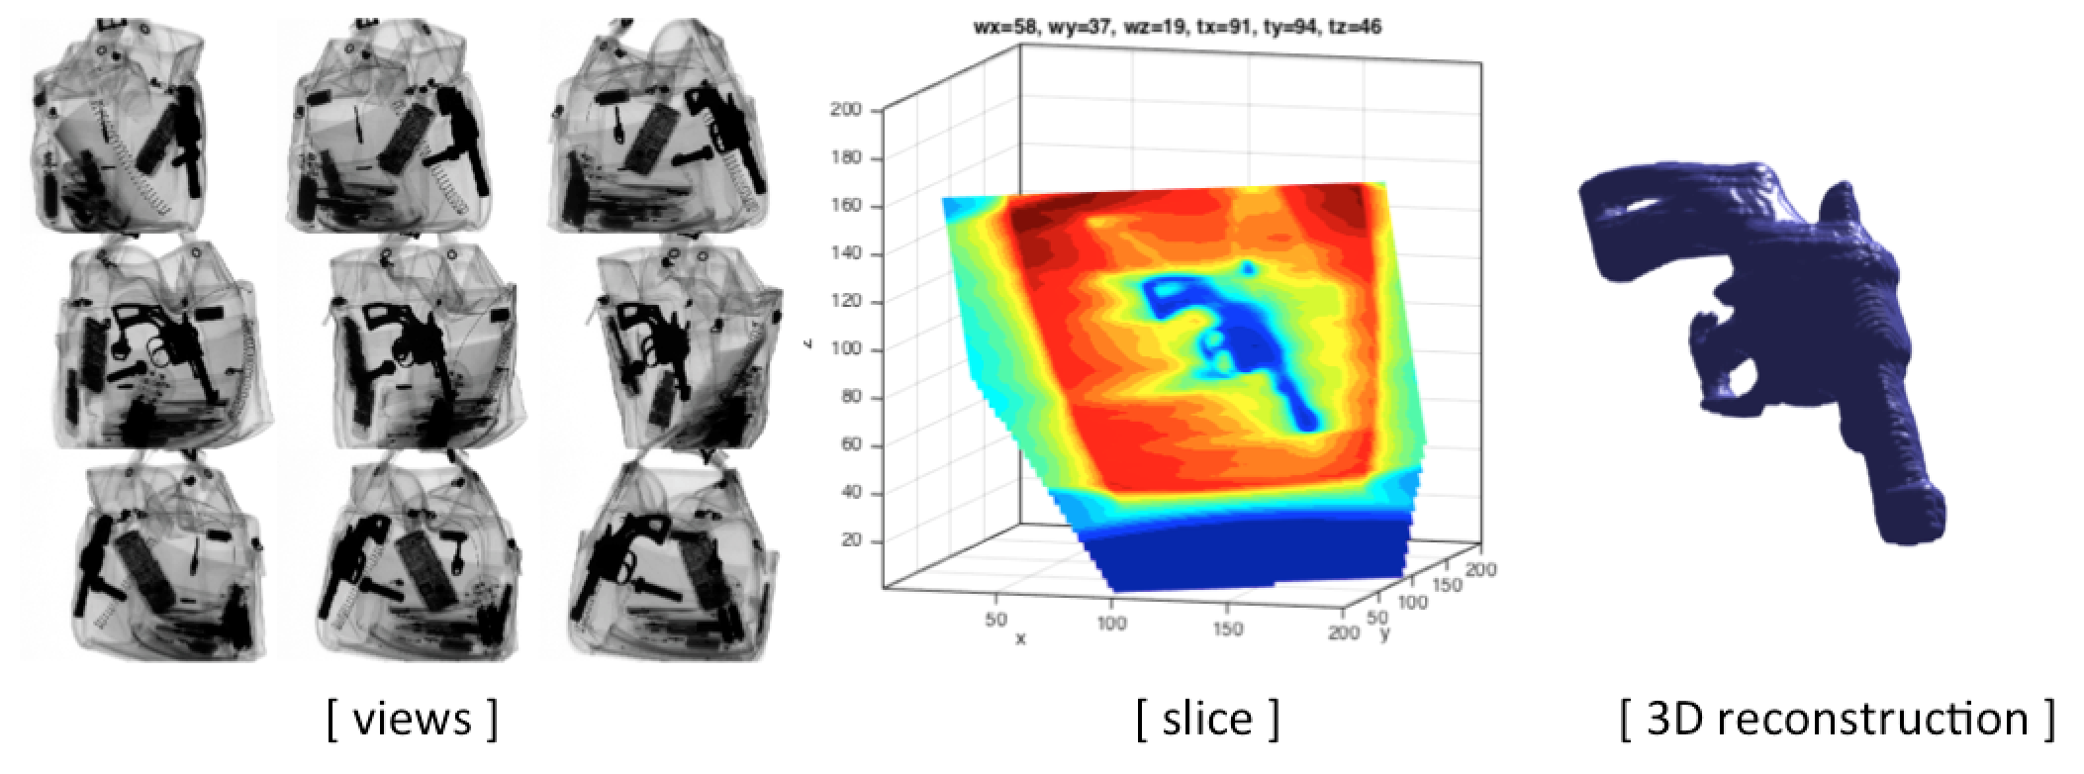
Principles: Computed Tomography

Slide 37
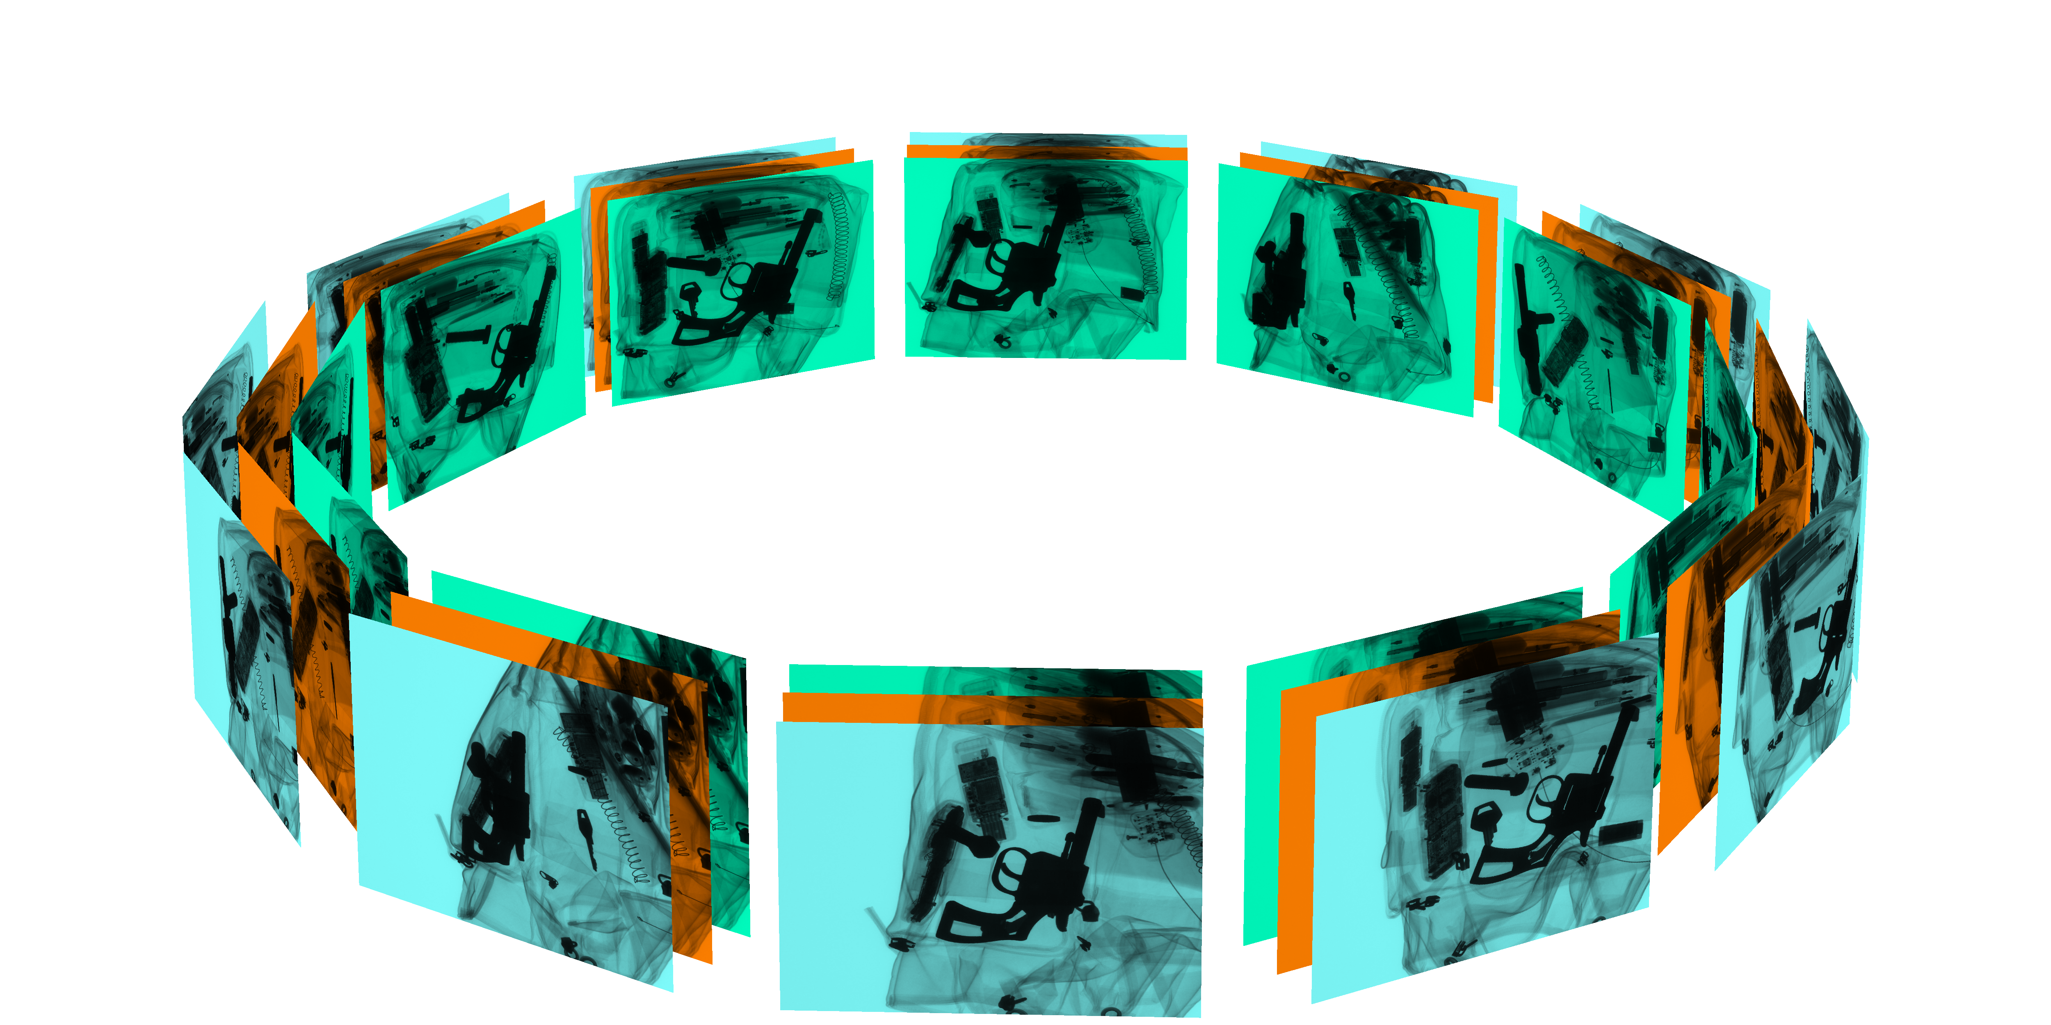
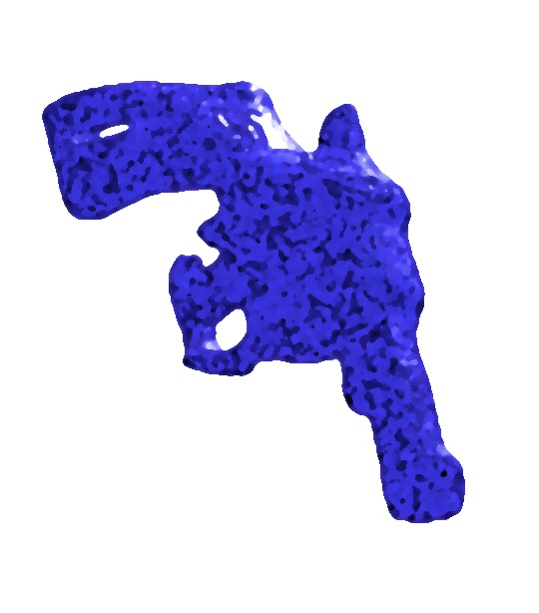
Principles: Computed Tomography – Multi Energy
Metallic object: handgun

Slide 38
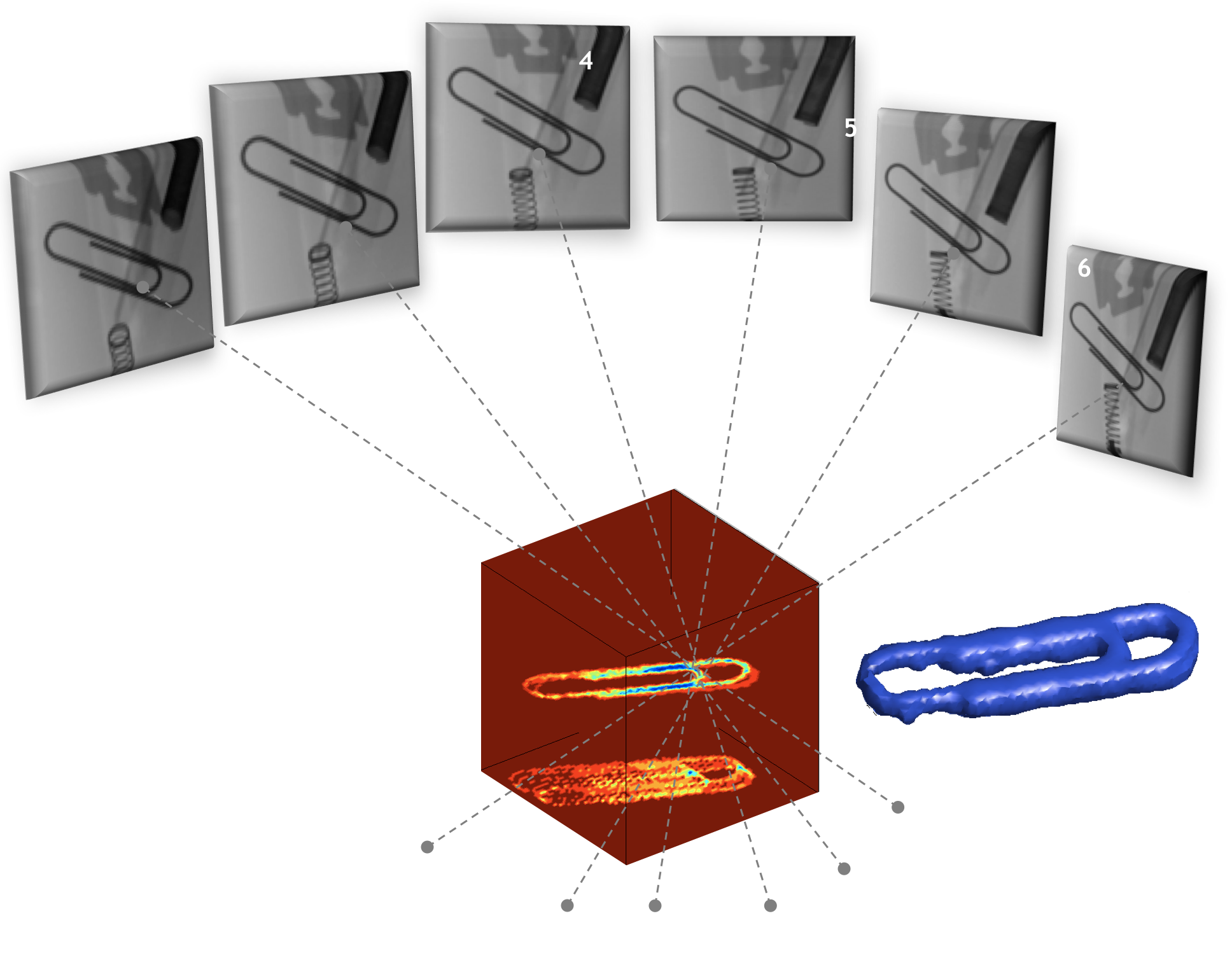
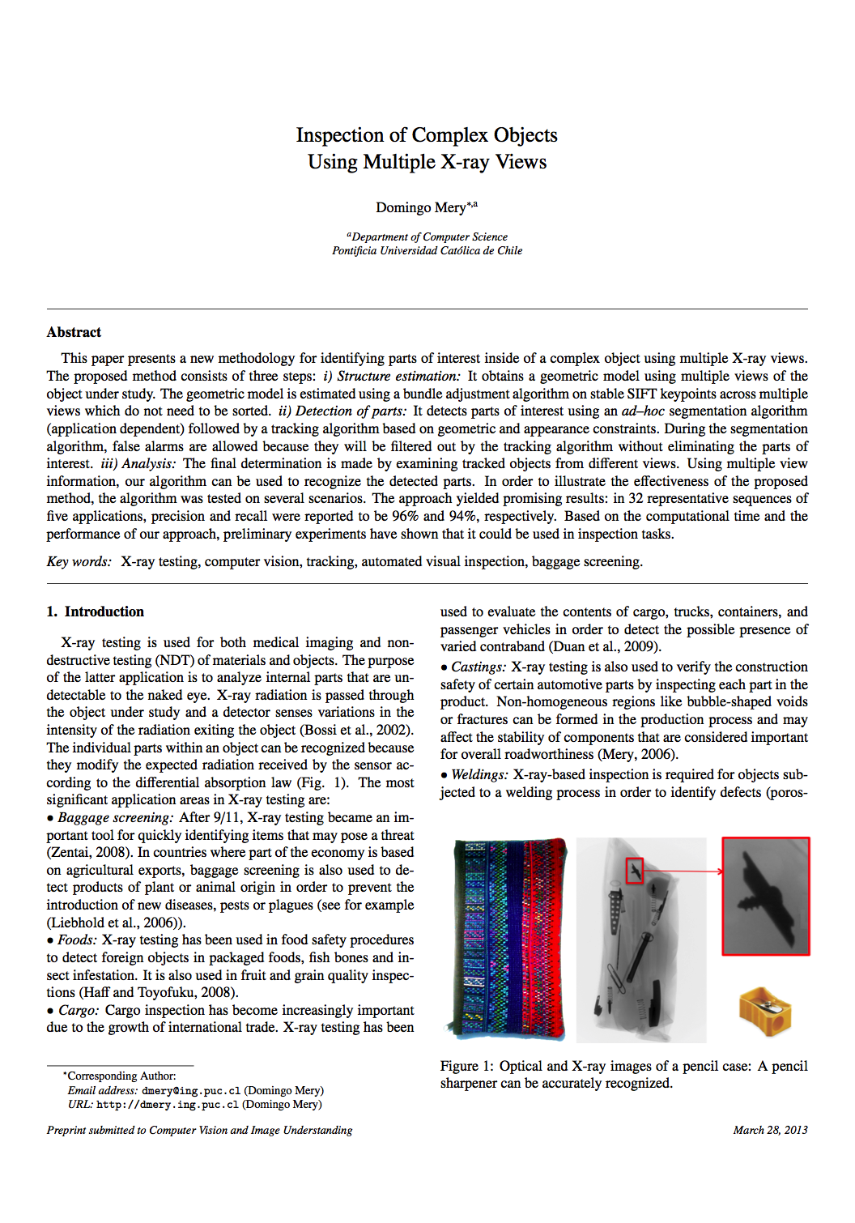
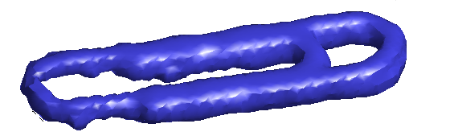
1
CT Method 1: Limited View & Limited Angle
D. Mery: Inspection of Complex Objects using Multiple X-ray Views, Submitted to CVIU, 2013.
[ R E J E C T E D ]
Notes:
for the sake of truth, the paper was rejected

Slide 39
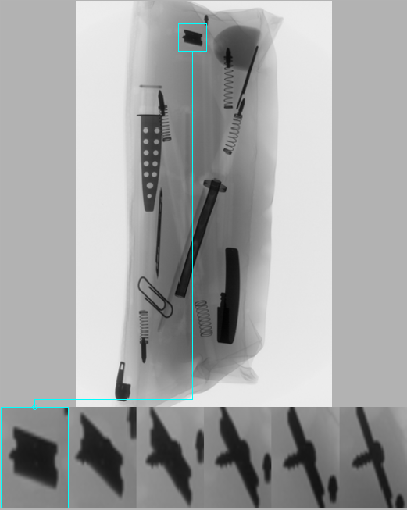
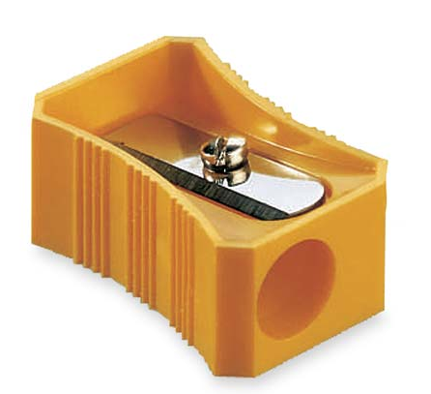
Principles: Multiple view analysis
1

Slide 40
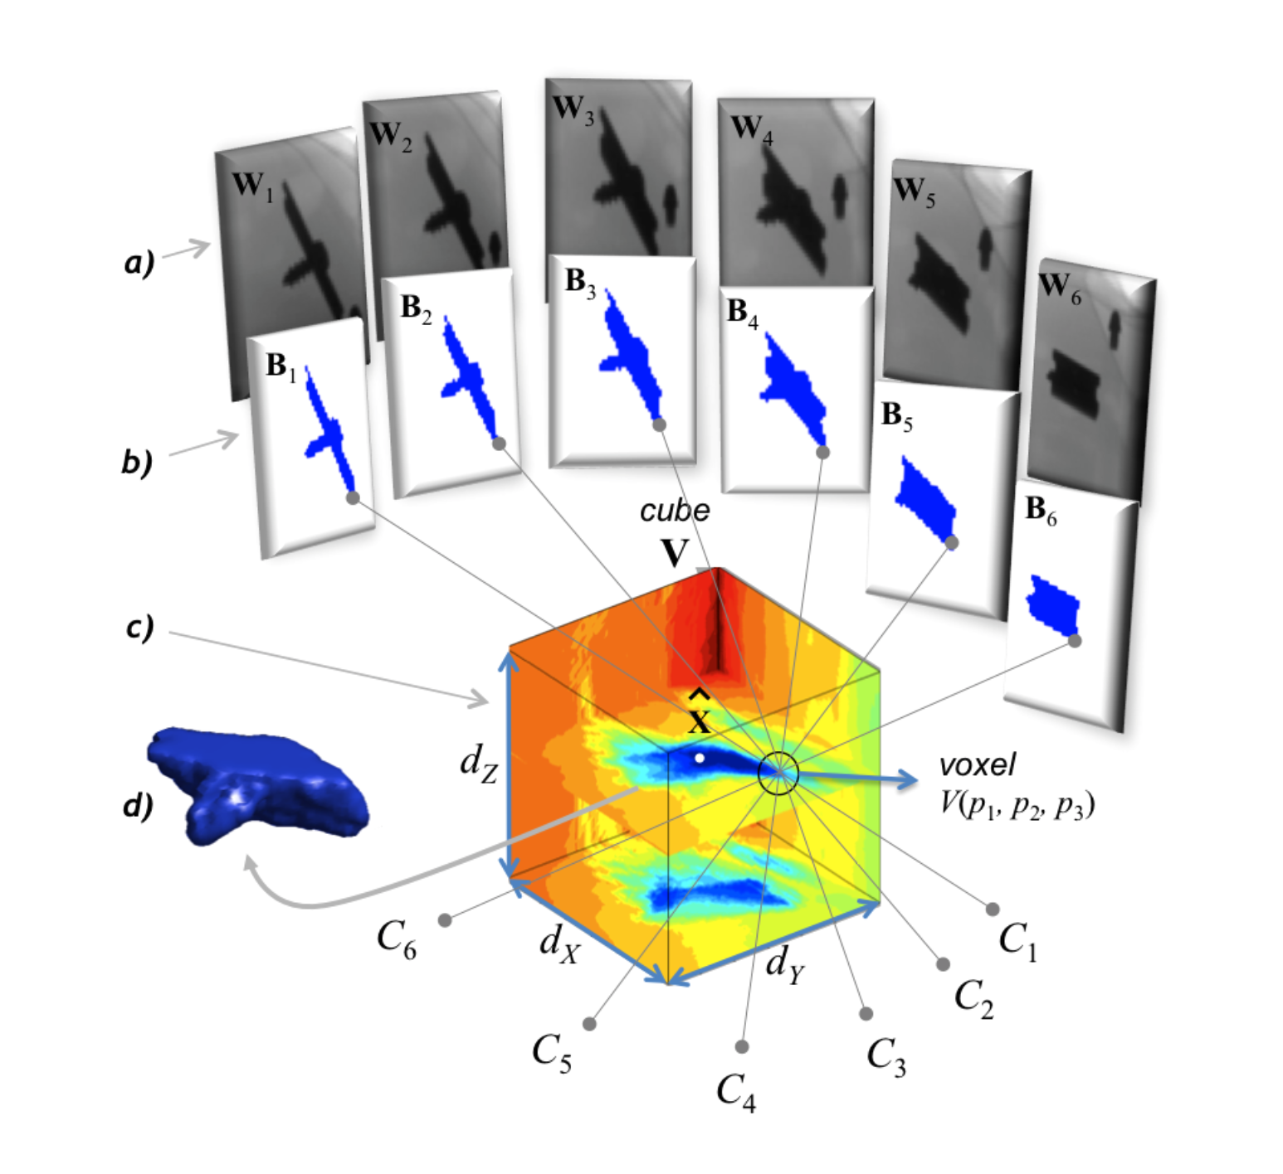
1
X-ray sequence
2D Segmentation
Tomography
3D Segmentation

Slide 41
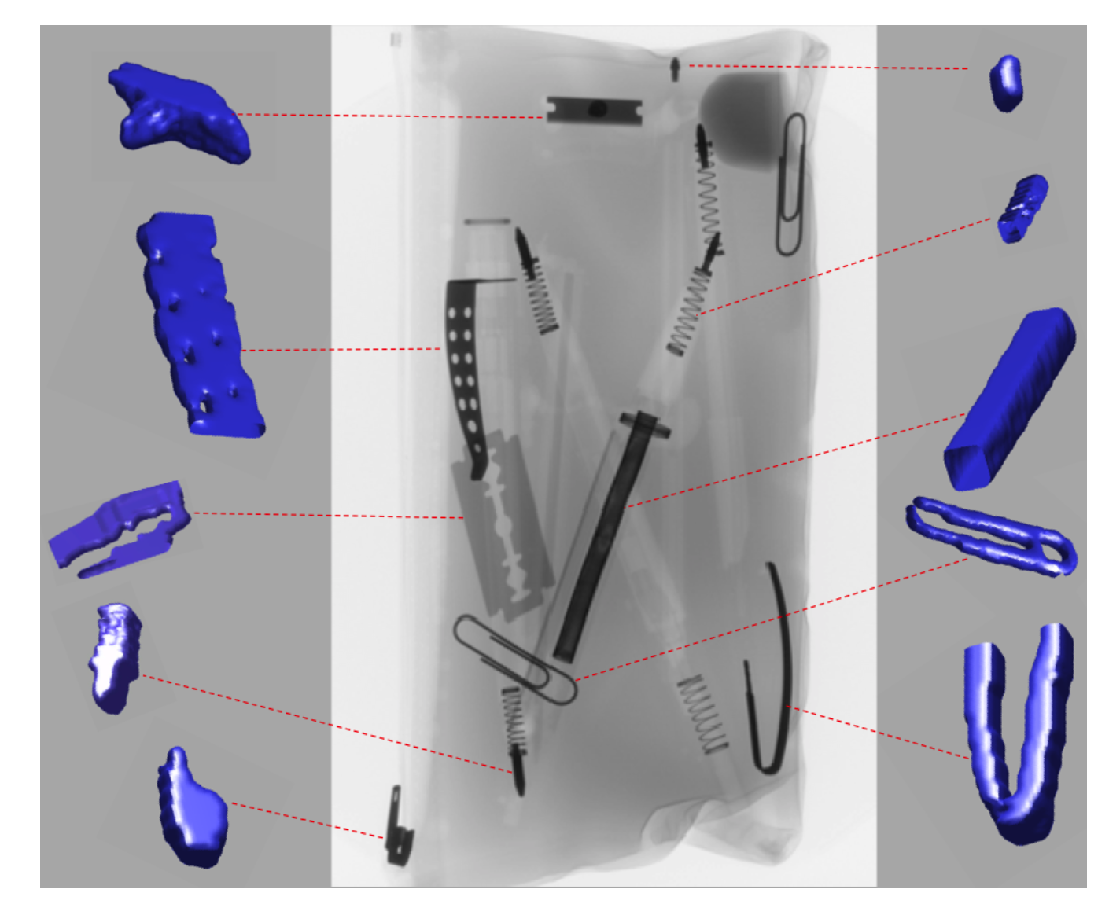
1

Slide 42
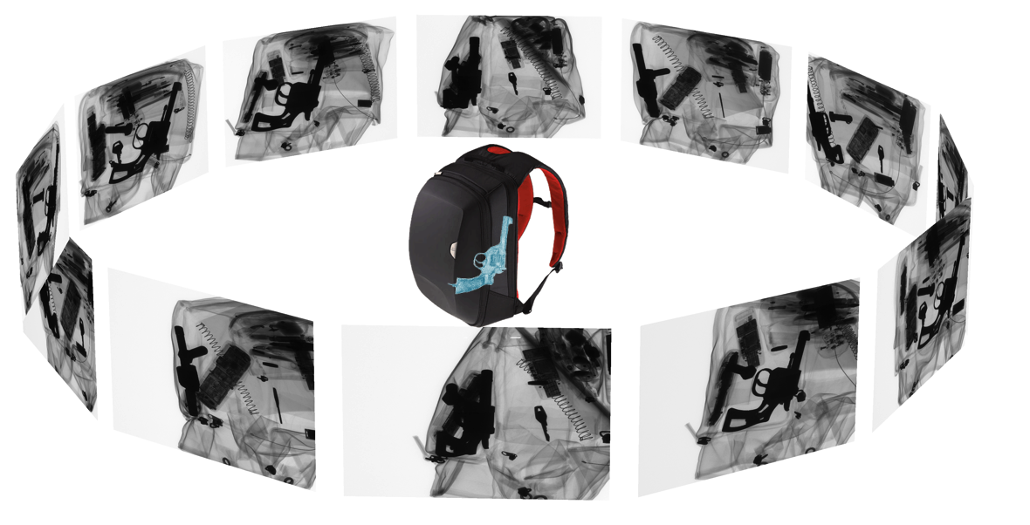
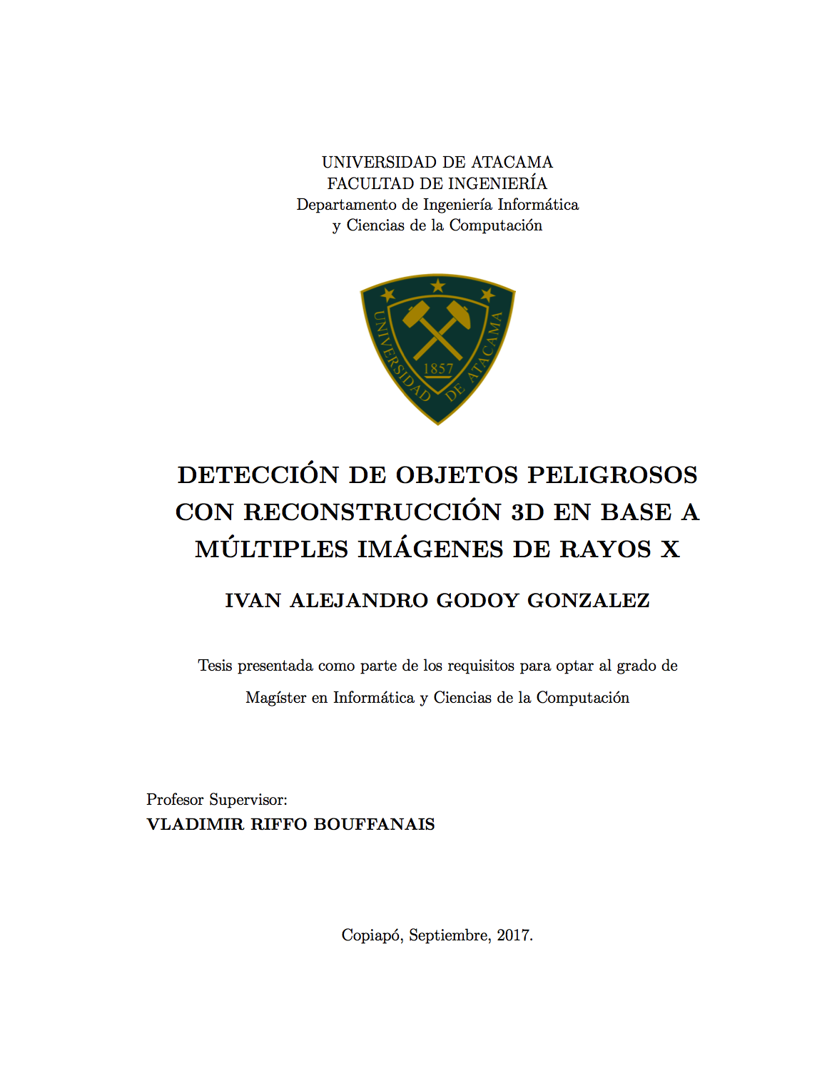
2
CT Method 2: Classic Computed Tomography
I. Godoy: Detection of Threat Objects using 3D Reconstruction from Multiple Views, Master Thesis, Universidad de Atacama, Chile, 2017.
Segmentation
Feature
Extraction
Classification

Slide 43

2
(c) Ivan Godoy & Vladimir Riffo, Universidad de Atacama

Slide 44

2
(c) Ivan Godoy & Vladimir Riffo, Universidad de Atacama

Slide 45


2
(c) Ivan Godoy & Vladimir Riffo, Universidad de Atacama

Slide 46

2
False Detection
(c) Ivan Godoy & Vladimir Riffo, Universidad de Atacama

Slide 47
Principles: General X-ray Testing Methodology
Views
Energies
multi • dual • mono
• computed tomography
• monocular
• multi-view
3D
Reconstruction
Image
Analysis
Multi-view
Analysis
Algorithms
Sparse
Representations
3D
Segmentation
Deep
Learning
Limited angle
CT
3D
Recognition

